Slide 1

시스템 프로그래밍
프로젝트
2017848028 김준우

Slide 2

목차
mkdir
pwd
rmdir
ls
cp
cd
cat
mv

Slide 3

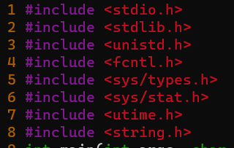
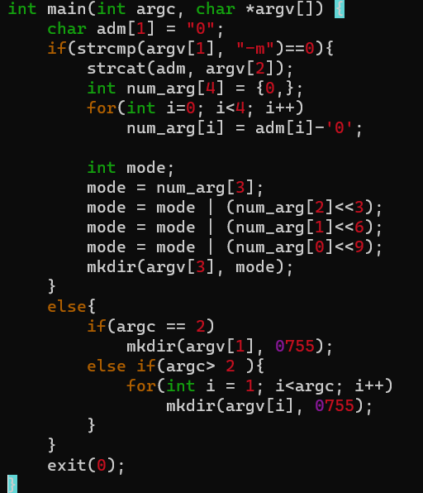
mkdir

Slide 4
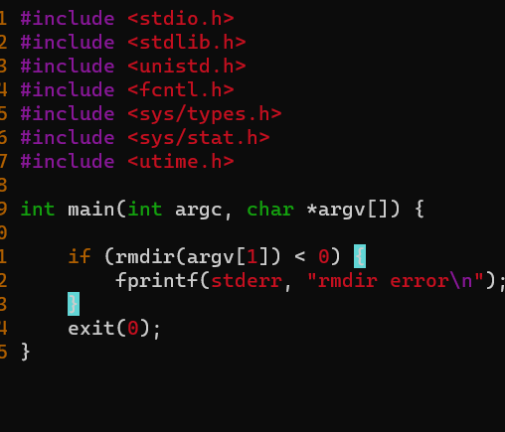
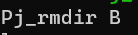
rmdir

Slide 5
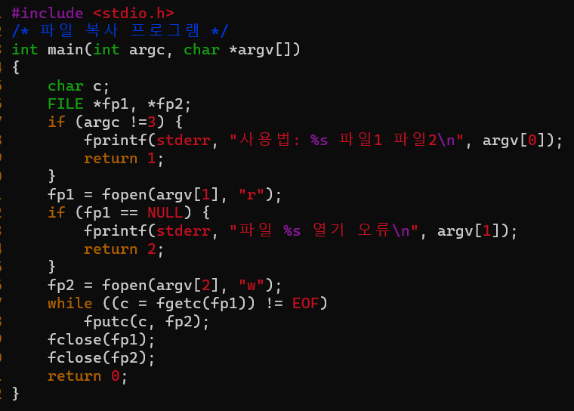
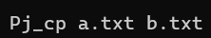
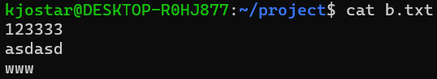
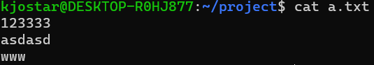
cp

Slide 6
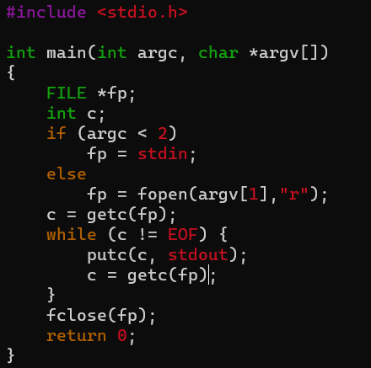
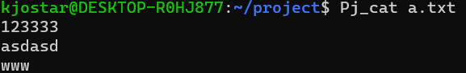
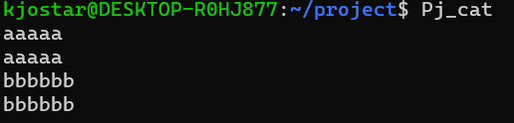
cat

Slide 7
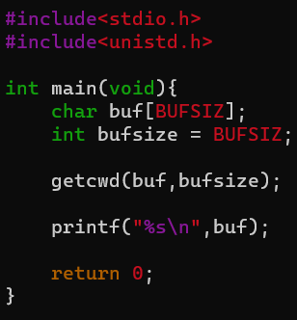
pwd

Slide 8
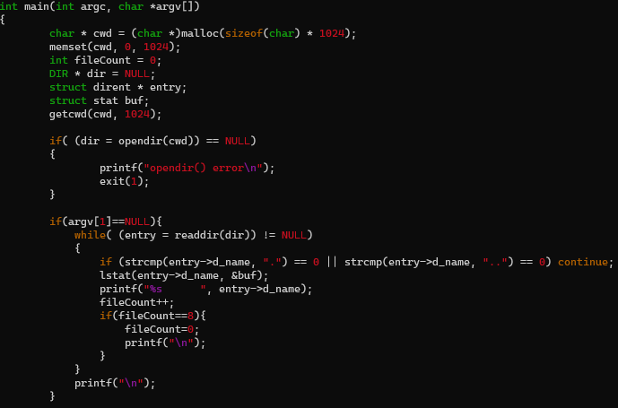
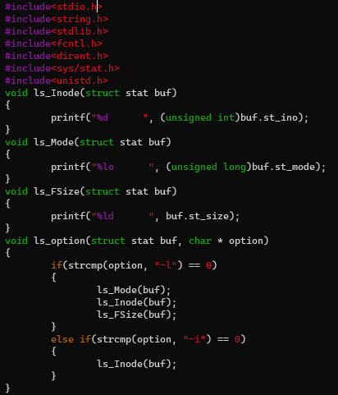
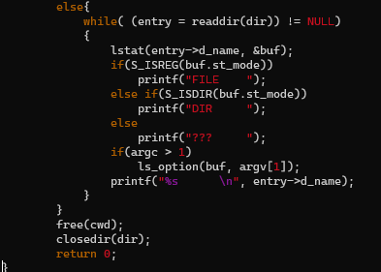
ls

Slide 9
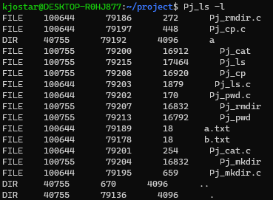
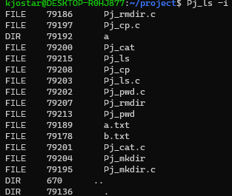
ls

Slide 10
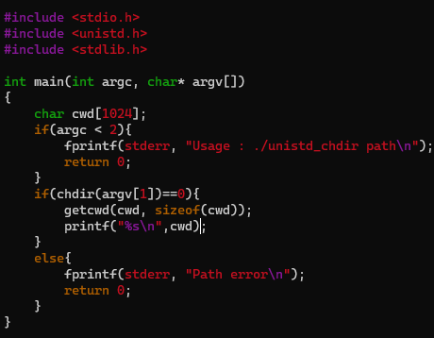
cd

Slide 11
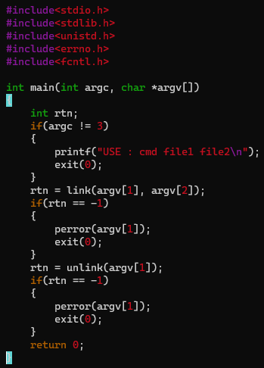
mv

Slide 12


출처
rmdir mkdir
https://bubble-dev.tistory.com/category/C%2CC%2B%2B%20%26%20Linux
cat, cp
PDF파일
ls
https://go-it.tistory.com/4
pwd
https://sosal.kr/126
cd
https://k-story.tistory.com/243
mv
https://m.blog.naver.com/PostView.naver?isHttpsRedirect=true&blogId=koleekr7&logNo=100096000814

